Slide 1

The National University of Computer and Emerging Sciences Peshawar Campus
Unsupervised Learning
Machine Learning for Data Science
Muhammad Zulqarnain
Department of Computer Science

Slide 2
Goals
Lecture slide credit goes to Dr. Akhtar Jamil from the National University of Computer and Emerging Sciences, Islamabad
(Email: akhtar.jamil@nu.edu.pk).

Slide 3
Unsupervised Learning
A machine learning technique in which data is given without labels.
No supervisor or teacher available
Model must discover patterns from the data itself.
Relationship exists between data
Exploits this relationship to learning
It needs more complex processing
Applications: Clustering, anomaly detection, document categorization, relevant news, Customer segmentation

Slide 4
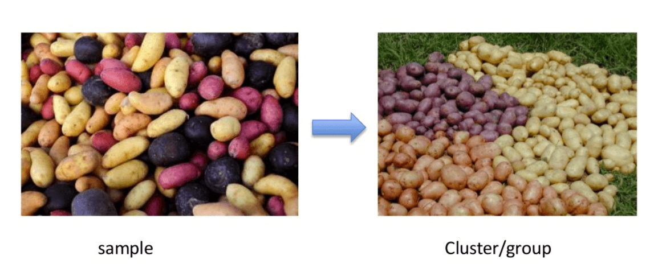
Unsupervised Learning

Slide 5
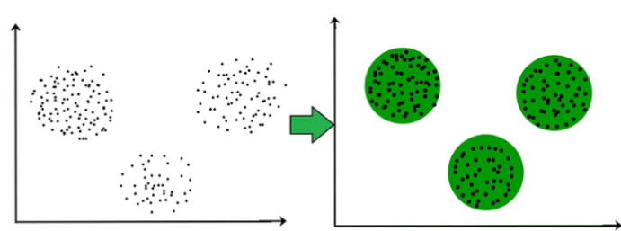
clustering
Notes:
Customer Segmentation: Businesses use K-means to segment their customer base into different groups based on purchasing behavior, demographics, or other attributes. This helps in targeted marketing and personalized service.
Image Compression: In image processing, K-means can reduce the number of colors in an image by clustering pixel colors, leading to compression.
Anomaly Detection: By clustering normal data, deviations from these clusters can be identified as anomalies. This is useful in fraud detection and network security.
Document Clustering: Grouping similar documents together based on their content or metadata can improve information retrieval systems

Slide 6
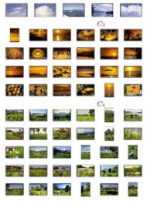
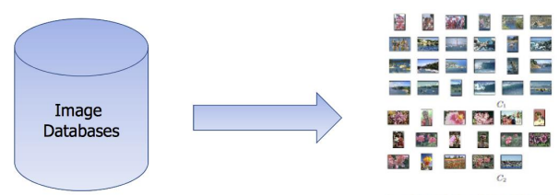
Unsupervised Learning

Slide 7
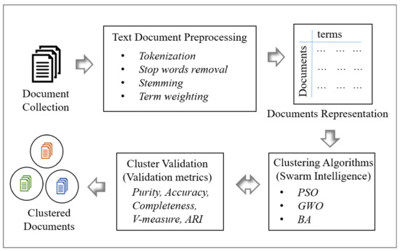
Unsupervised Learning

Slide 8
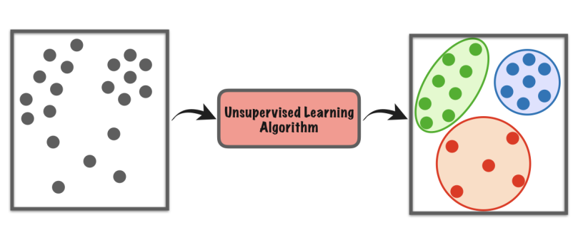
Unsupervised Learning
Why they are in one group?

Slide 9
Unsupervised Learning
Various Unsupervised learning approaches:
Clustering
Local Outlier Factor
Expectation–maximization
Principal component analysis
Independent component analysis
Non-negative matrix factorization
Singular value decomposition
Isolation Forest

Slide 10
Clustering
Partition unlabeled examples into disjoint subsets of clusters (Groups), such that:
Samples within a cluster are very similar
Samples in different clusters are very different
Discover new categories in an unsupervised manner
No labels provided.

Slide 11
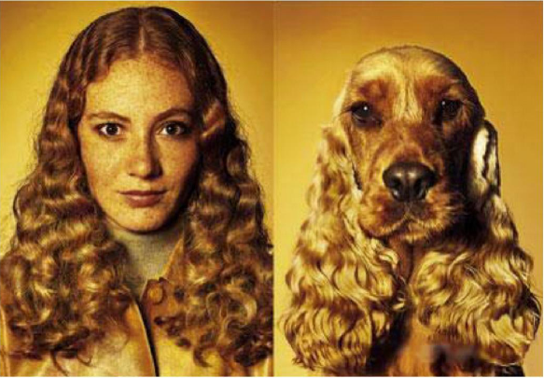
Similar or Dissimilar?

Slide 12
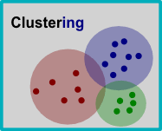
Clustering
Select a Similarity / Dissimilarity function
Group samples based on this function
Similar ones be in one cluster
Different put in other cluster

Slide 13
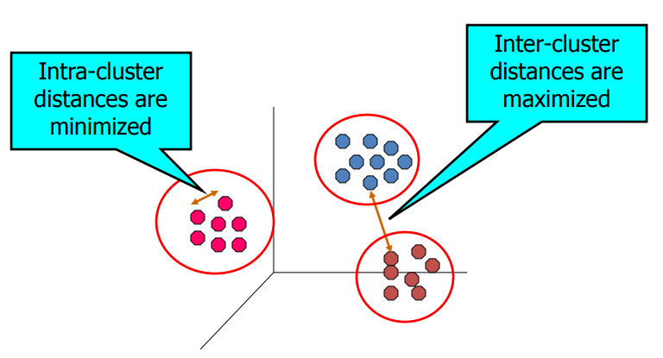
Clustering

Slide 14
Clustering
There are many types of clustering algorithms.
Many algorithms use similarity or dissimilarity criteria
The way they find the grouping is different.
Some popular clustering algorithms are:
K-Means Clustering
Agglomerative Clustering
Hierarchical Clustering
Mean Shift
Spectral Clustering
Mixture of Gaussians

Slide 15
K-Means Clustering
K-means clustering is a very famous, simple and powerful unsupervised machine learning algorithm.
Has been applied to many complex unsupervised machine learning problems.
A K-means clustering algorithm tries to group similar items in the form of clusters.
The number of groups is represented by K. It should be given beforehand.
K should be predetermined

Slide 16
K-Means Clustering
Each cluster is associated with a centroid (center point)
Each point is assigned to the cluster with the closest centroid
Number of clusters, K, must be specified
The objective is to minimize the sum of distances of the points to their respective centroid

Slide 17
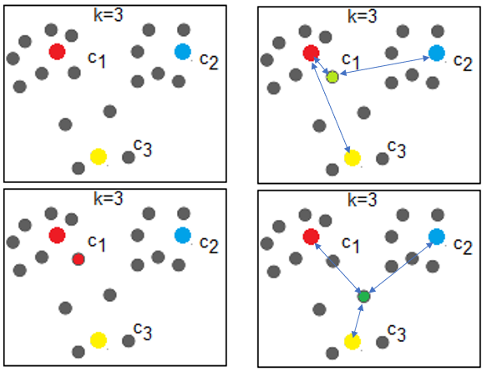
K-Means Clustering

Slide 18
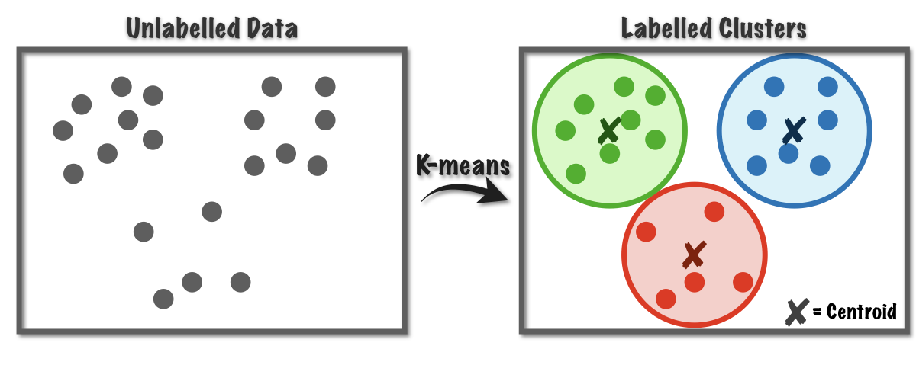
K-Means Clustering

Slide 19
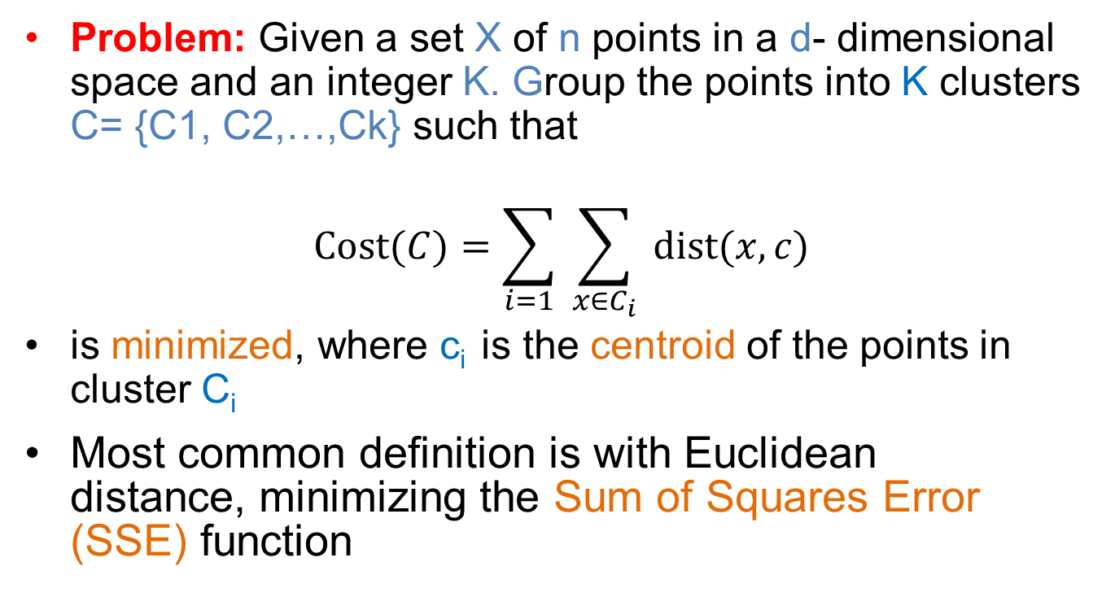
K-Means Clustering
Problem: Given a set X of n points in a d- dimensional space and an integer K. Group the points into K clusters C= {C1, C2,…,Ck} such that
$$Cost⁡(C)=\sum_{i=1}{ }\sum_{x∈C_{i}}{ }dist⁡(x,c)$$
is minimized, where c_{i} is the centroid of the points in cluster C_{i}
Most common definition is with Euclidean distance, minimizing the Sum of Squares Error (SSE) function

Slide 20
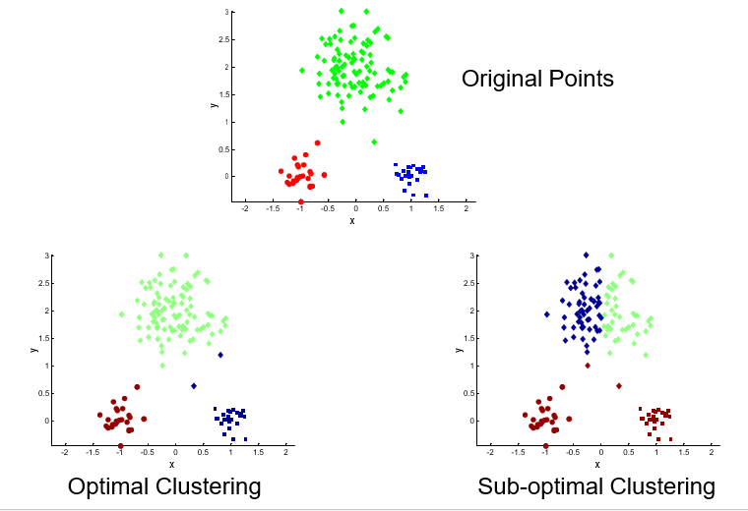
K-Means Clustering
Initial centroids are often chosen randomly.
Clusters produced vary from one run to another.

Slide 21
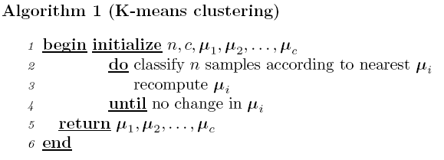
K-Means Clustering

Slide 22
K-Means Clustering
Initialization of cluster centers
Do multiple runs and select the clustering with the s mallest error
Select the original set of points by methods other than random .
E.g., pick the most distant (from each other) points as cluster centers (K-means++ algorithm)

Slide 23
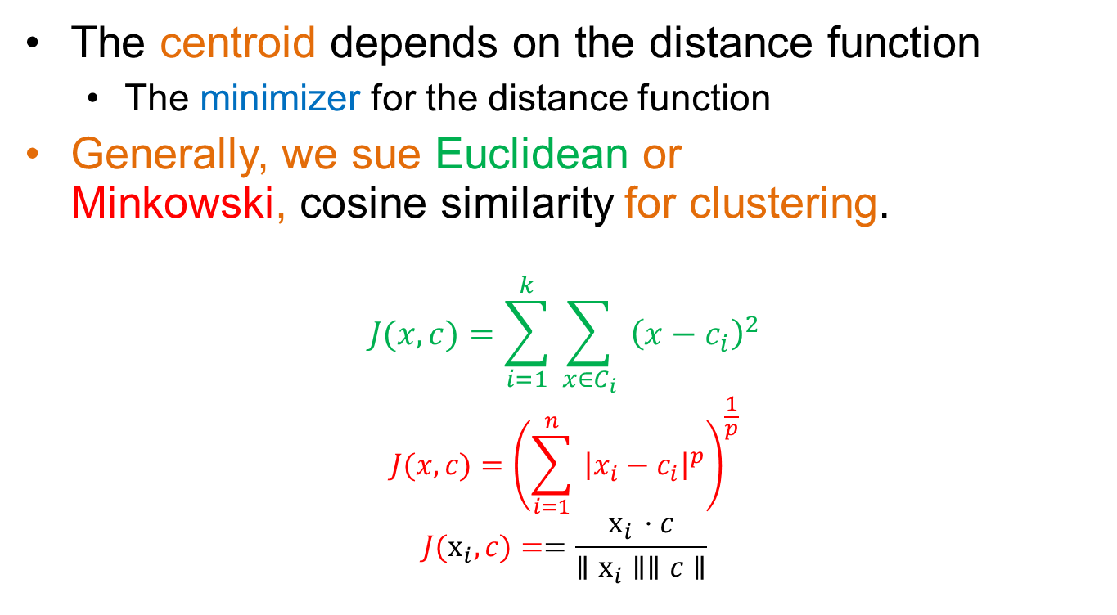
K-Means Clustering
The centroid depends on the distance function
The minimizer for the distance function
Generally, we sue Euclidean or Minkowski, cosine similarity for clustering.
$$J(x,c)=\sum_{i=1}^{k}{ }\sum_{x∈C_{i}}{ }{\left(x−c_{i}\right)}^{2}$$
$$J(x,c)={\left(\sum_{i=1}^{n}{ }{\left|x_{i}−c_{i}\right|}^{p}\right)}^{\frac{1}{p}}$$
$$J(x_{i},c)==\frac{x_{i}⋅c}{∥x_{i}∥∥c∥}$$

Slide 24

K-Means Clustering
New Centroid:
$$Centroid\left(ki\right)= \frac{1}{Ni}\sum_{j=1\text{∈}Ni }{x_{j} }$$
$Ni$ is number of samples in i^{th} cluster

Slide 25
K-Means Clustering
K-means will converge for common similarity measures mentioned above.
Most of the convergence happens in the first few
iterations.
Often the stopping condition is changed to ‘Until relatively few points change clusters’
Complexity is O( n * K * I * d )
n = number of points, K = number of clusters, I = number of iterations, d = dimensionality
In general a fast and efficient algorithm

Slide 26
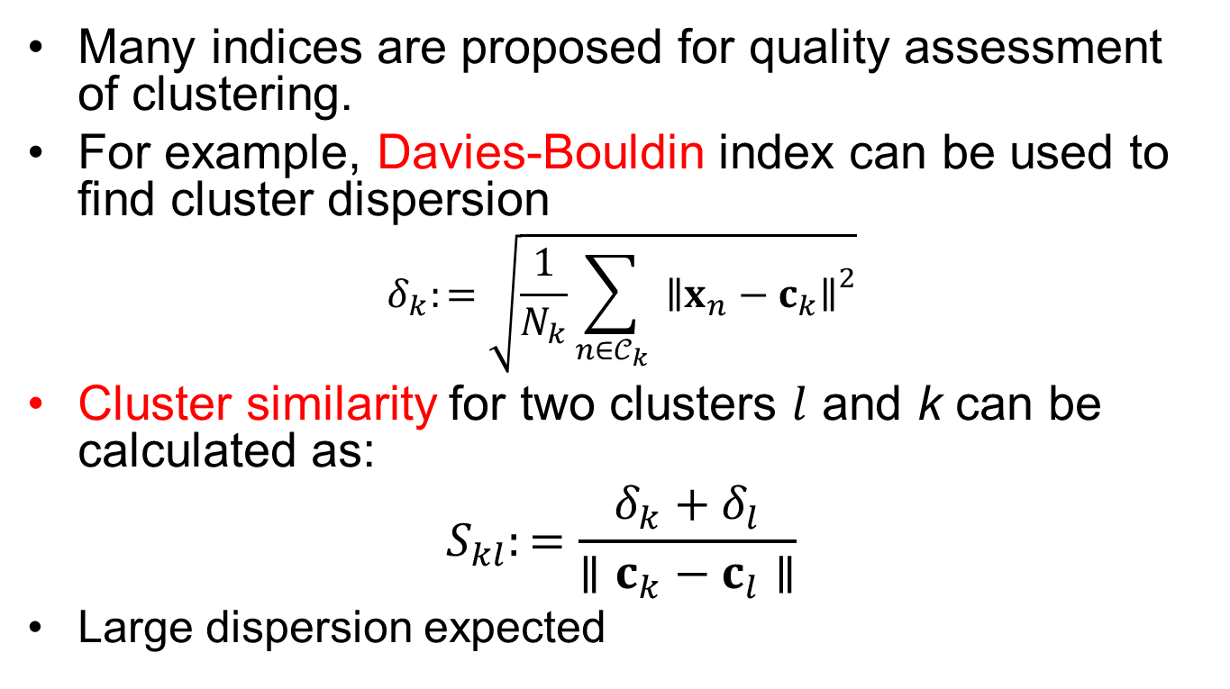
Evaluate the quality of a clustering
Many indices are proposed for quality assessment of clustering.
For example, Davies-Bouldin index can be used to find cluster dispersion
$$δ_{k}:=\sqrt{\frac{1}{N_{k}}\sum_{n∈𝒞_{k}}{ }{∥x_{n}−c_{k}∥}^{2}}$$
Cluster similarity for two clusters $l$ and k can be calculated as:
$$S_{kl}:=\frac{δ_{k}+δ_{l}}{∥c_{k}−c_{l}∥}$$
Large dispersion expected

Slide 27
Disadvantages
K-means has problems when clusters are of different
Sizes
Densities
Complex shapes
K-means has problems when the data contains outliers.

Slide 28
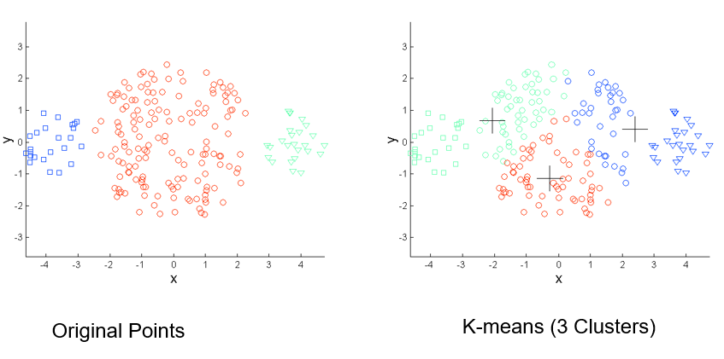
Disadvantages

Slide 29
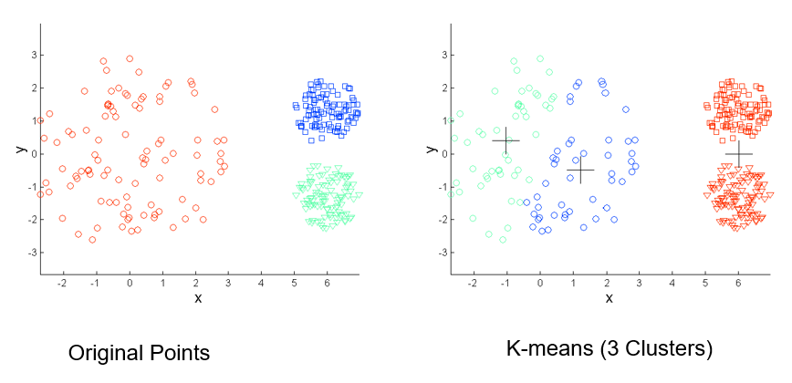
Disadvantages

Slide 30
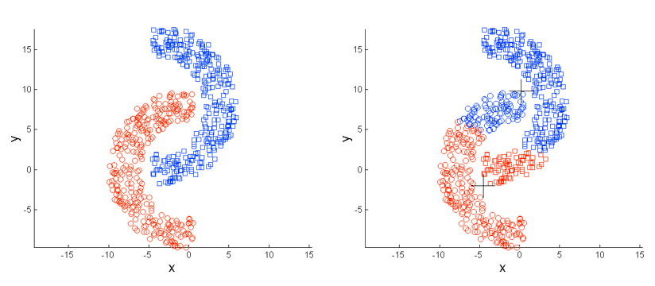
Disadvantages

Slide 31
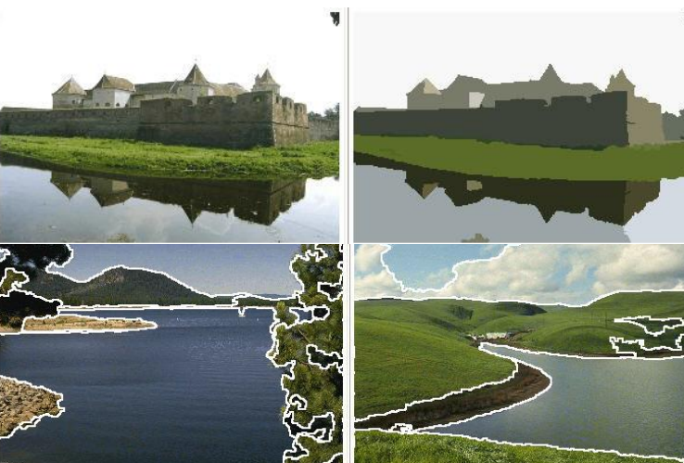
Example for Image Segmentation

Slide 32
Numerical Example
https://www.saedsayad.com/clustering_kmeans.htm

Slide 33
References

Slide 34
Thank You ☺

